Slide 1
Big Data Streaming Architecture on HDP 3.0

Slide 2
IoT - Relevance
7.2 Billion active SIM Cards
25 Billion connected things
500 Million tweets per day
  Average life of a tweet is 18 minutes
2 Zettabytes per year of Global IP Traffic
  80% is unstructured

Slide 3
5 Attributes of a Streaming Platform
Ingest
Process
Analyze
Respond
Visualize

Slide 4
Data Flow versus Stream Analytics for IoT
Data Flow
  Ingest and route terabytes data into a ”unified firehose”
  Actively performance manage the latency and quality of these data flows –
  Across high variability of data formats, size of data and speed of data
Real Time Stream Analytics
  Sub second event processing with linear scalability to billions of events
  Predictive Analytics at Scale
    Real time data aggregation across edge nodes while processing 10s of millions of events and 100s of gigabytes per second
  Guaranteed no data loss and events processed in order

Slide 5
6 Focus for Building a Streaming Platform for IoT
Common Abstraction Layer
Latency
Lambda Architecture
  “Orchestrate” over static and real time data
Scale-out
Rapid Application Development
Data Visualization

Slide 6
Focus Areas for Streaming Platform for IoT
1 . Common Abstraction Layer
    Select one or more streaming engines
    Select one or more cloud providers
    Select one or more resource managers
    Select one or more event sources
    ...Future Proof

Slide 7
Focus Areas for Streaming Platform for IoT
2 . Latency
    500 millisecond or less- Dashboards, Security Incidents, Asset Performance
    20 milliseconds or less - Ad Networks, Preventive Maintenance

Slide 8
Focus Areas for Streaming Platform for IoT
3 . Lambda Architecture
    Integrate static and real time data
    Enrichment
    Orchestration of Batch workflows
    Predictive Classification and Scoring

Slide 9
Focus Areas for Streaming Platform for IoT
4 . Scale Out
    Linear Scale out or scale down
    Resource Management
    Handle Transient workloads

Slide 10
Focus Areas for Streaming Platform for IoT
5 . Rapid Application Development
    Industry vertical specific applications
    Aggregations
    Filters
    Multi Stream Correlations
    Splits
    Joins
    Normalizations
    Business Rules Editor

Slide 11
Focus Areas for Streaming Platform for IoT
6. Data Visualization
    Time Series Visualizations
    Metrics Dashboarding
    Trends
    Comparisons
    Thresholds
    Custom UI extensions

Slide 12
6 Focus for Building a Streaming Platform for IoT
Abstracts underlying Streaming Engine- Storm, Spark Streaming, Flink..
OOTB Support for multiple (cloud) event sources - Kafka, AWS Kinesis, Azure Event Hub
Built-in Operators for Complex Event Processing
Built-in Real Time Dashboarding- Metrics and Events
PMML Support
Pluggable Workflow Management
Business Rules Editor and Rapid Application Development Framework
Cloud Deployment
Scalable Architecture
Handles different latency requirements

Slide 13
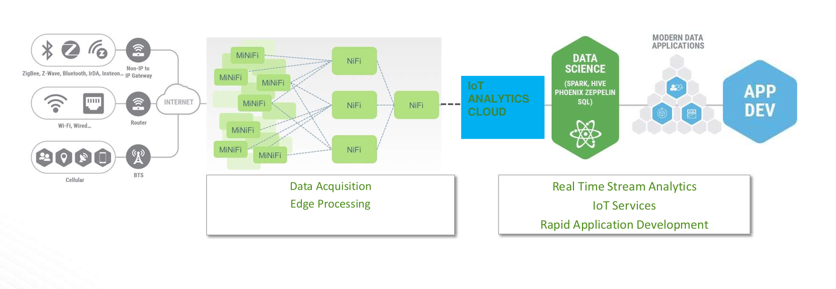
Hortonworks IoT Platform

Slide 14
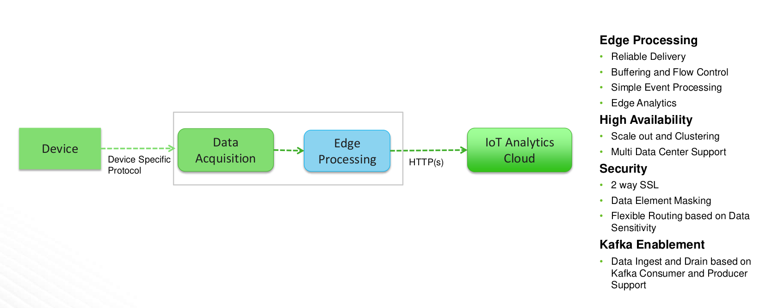
IoT Edge
Data Acquisition & Processing

Slide 15
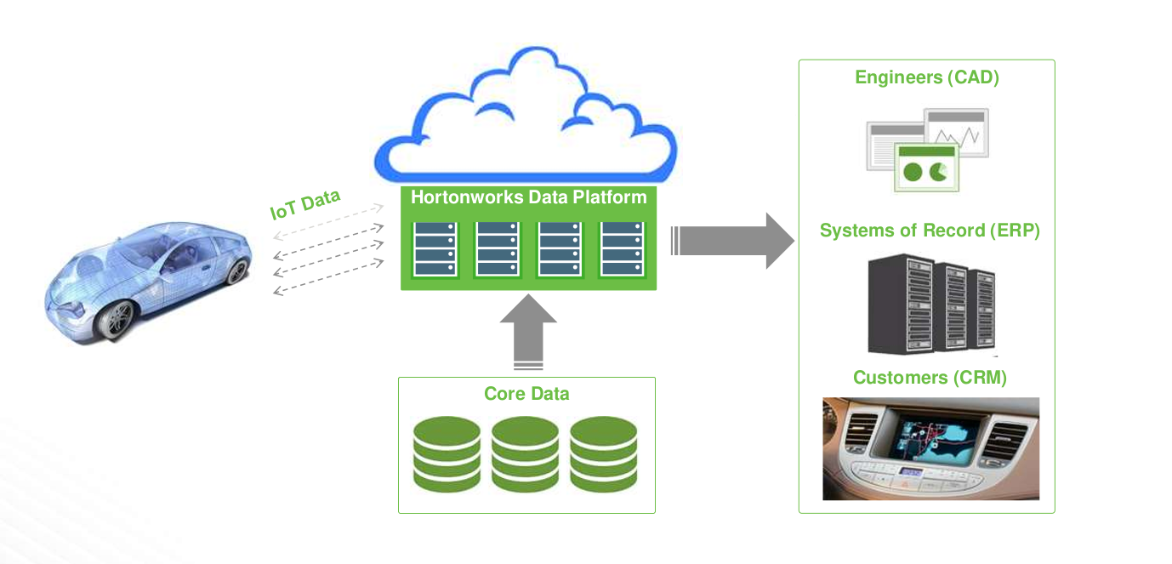
Reference Architecture

Slide 16
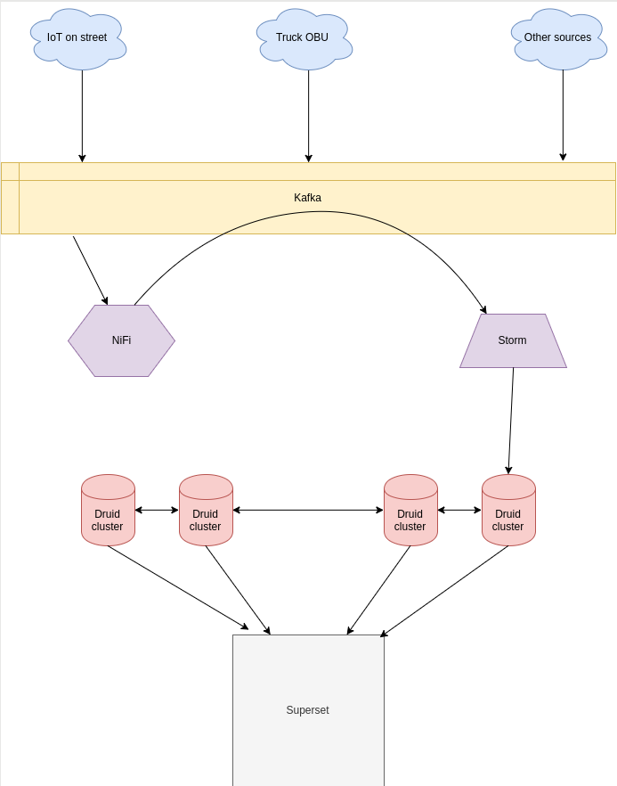
Demo Architecture by my son

